Slide 1
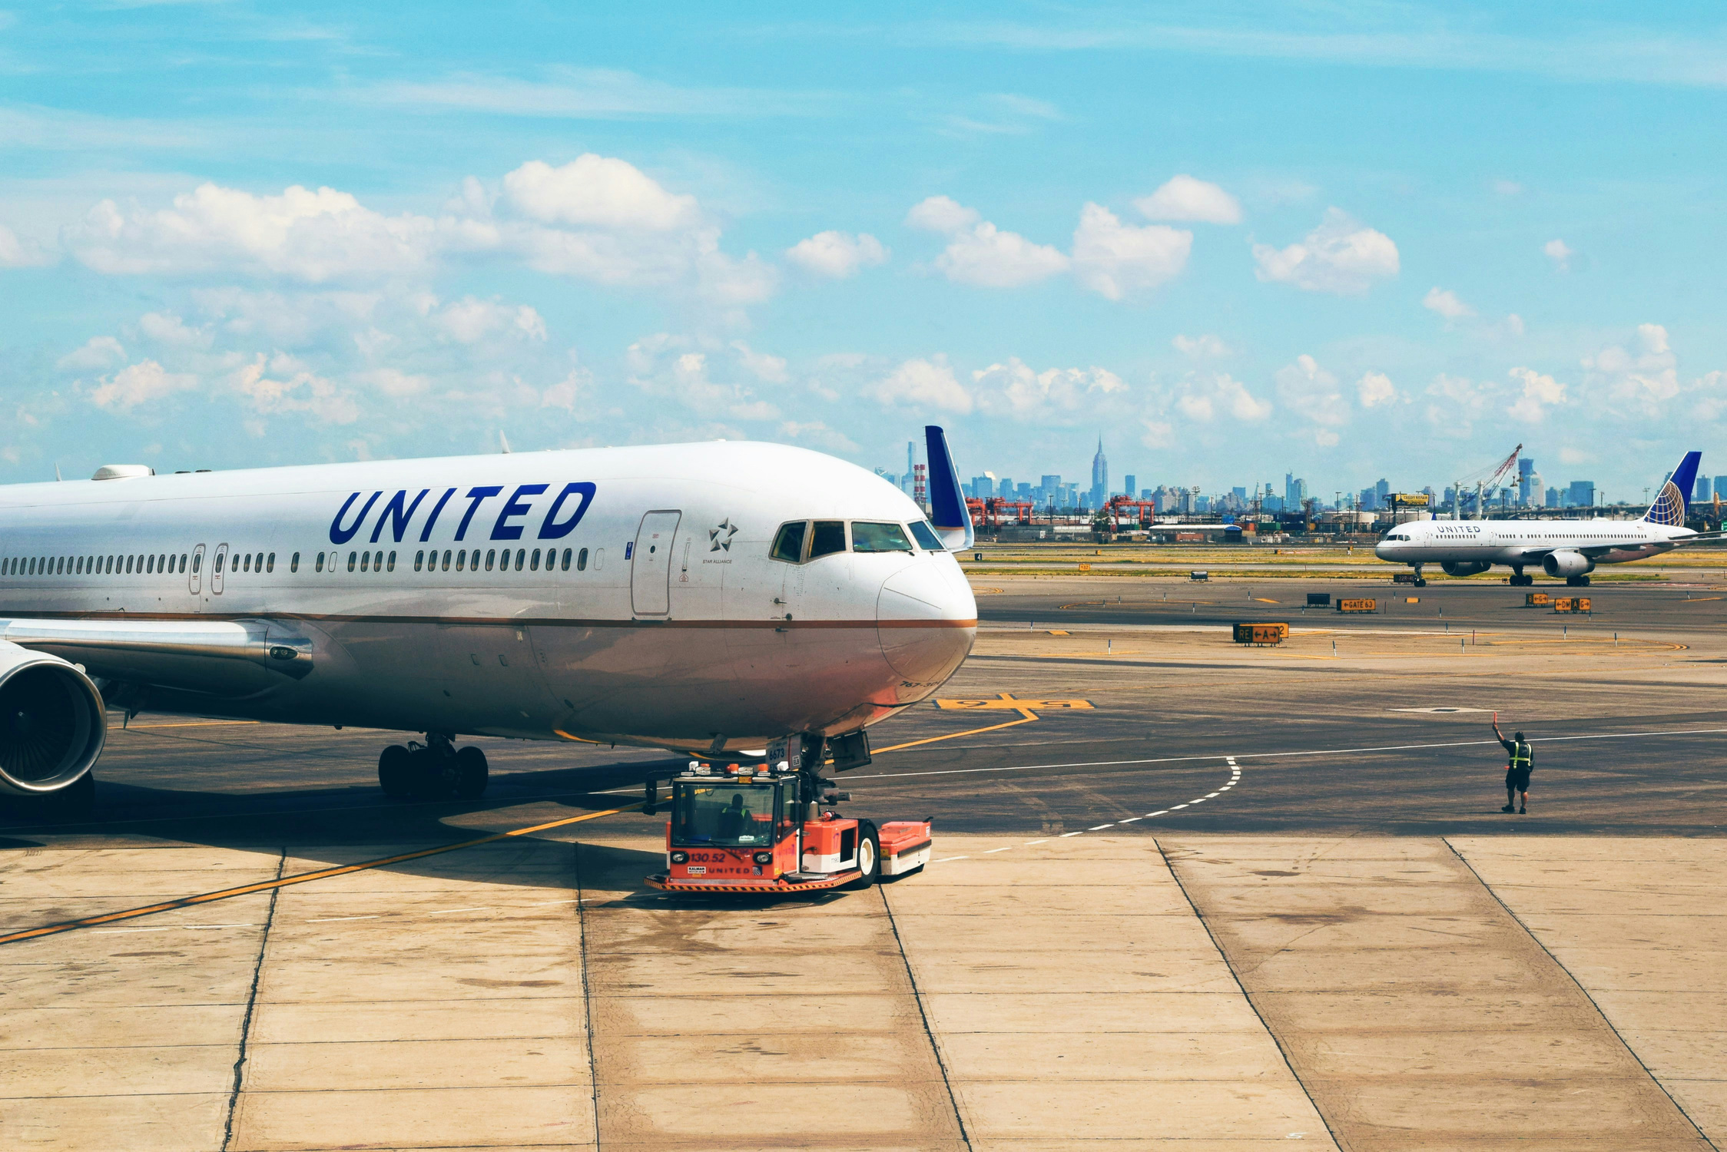

UNITED AIRLINES HACKATHON-SKYHACK 2.0
TEAMMATES
1.MOHD SHOHEL
2.DEEPAK KUMAR
Department of computer science,University Of Delhi

Slide 2

STEPS
Using regex removing special characters,trailing and leading spaces from primary_call_reason in reason dataset.Also finding missing and NAN values in customer dataset elite_level_code and fill with mode value and similarly done for sentiment dataset
Using Barplot ,Bargraph and Boxplot
Preprocessing
Feature Eengineering
DATA
VISULAIZATION
DELIVERABLES
Load Dataset
calculation of
AHT = Total Handle Time / Total Number of Calls
AST = Total Waiting Time / Total Number of Calls
with the help of call_start_datetime, agent_assigned_datetime and call_end_datetime
Load all csv files and understand the attribute present in these files

Slide 3

1
DELIVERABLE
Explore the factors contributing to extended call durations, such as agent performance, call types, and sentiment. Identify key drivers of long AHT and AST, especially during high volume call periods.
Agent Performance-: The tone and behavior of agents during calls can significantly influence call durations. Agents who maintain a calm and friendly tone may handle calls more efficiently, whereas those who are neutral or frustrated may lead to longer calls.
Call types:-Different types of calls, categorized by the primary reason for the call (i.e checkouts,irrops), may require varying levels of complexity. Calls that involve more detailed explanations or troubleshooting are likely to take longer.The most frequent call reason is irrops and least frequent call reason is unaccompanied minor.
Customer Sentiment:-The sentiment of customers (i.e frustrated, calm) can greatly influence both AHT and AST. Frustrated customers may require more time and attention, resulting in longer AHT. Additionally, higher silence percentages during calls may indicate hesitation or confusion from the customer.
Thynk Unlimited

Slide 4
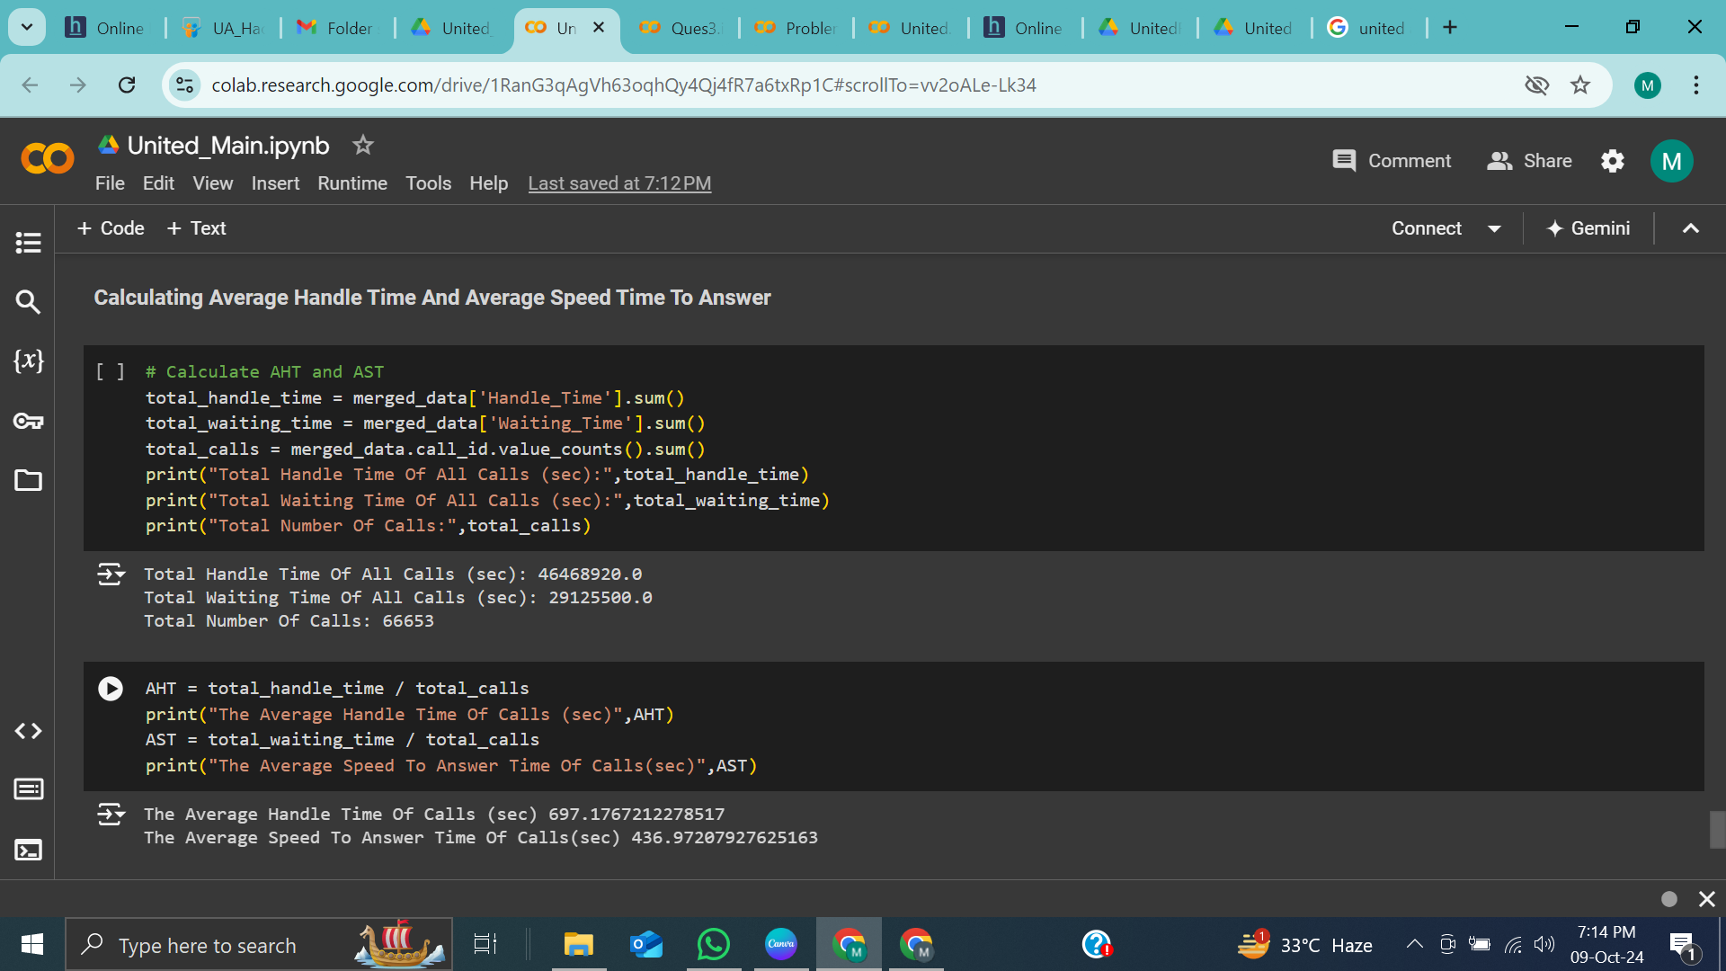
Total Handle Time Of All Calls (sec): 46468920.0
Total Waiting Time Of All Calls (sec): 29125500.0
Total Number Of Calls: 66653
The Average Handle Time Of Calls (sec) 697.1767212278517
The Average Speed To Answer Time Of Calls(sec) 436.97207927625163
Thynk Unlimited

Slide 5
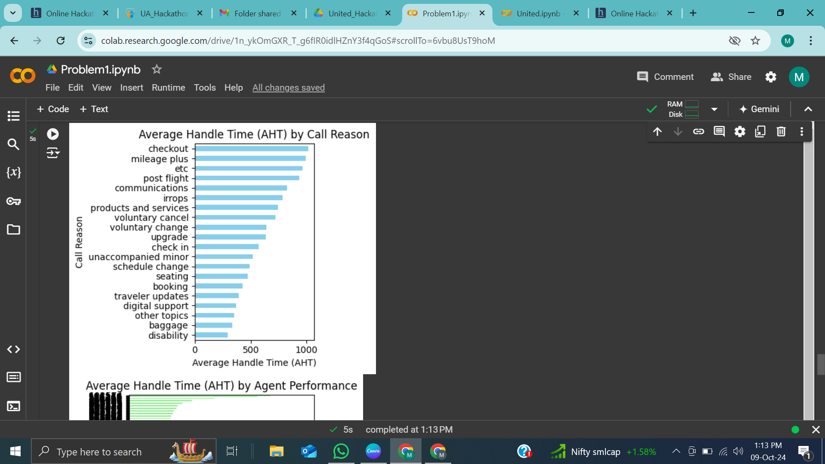
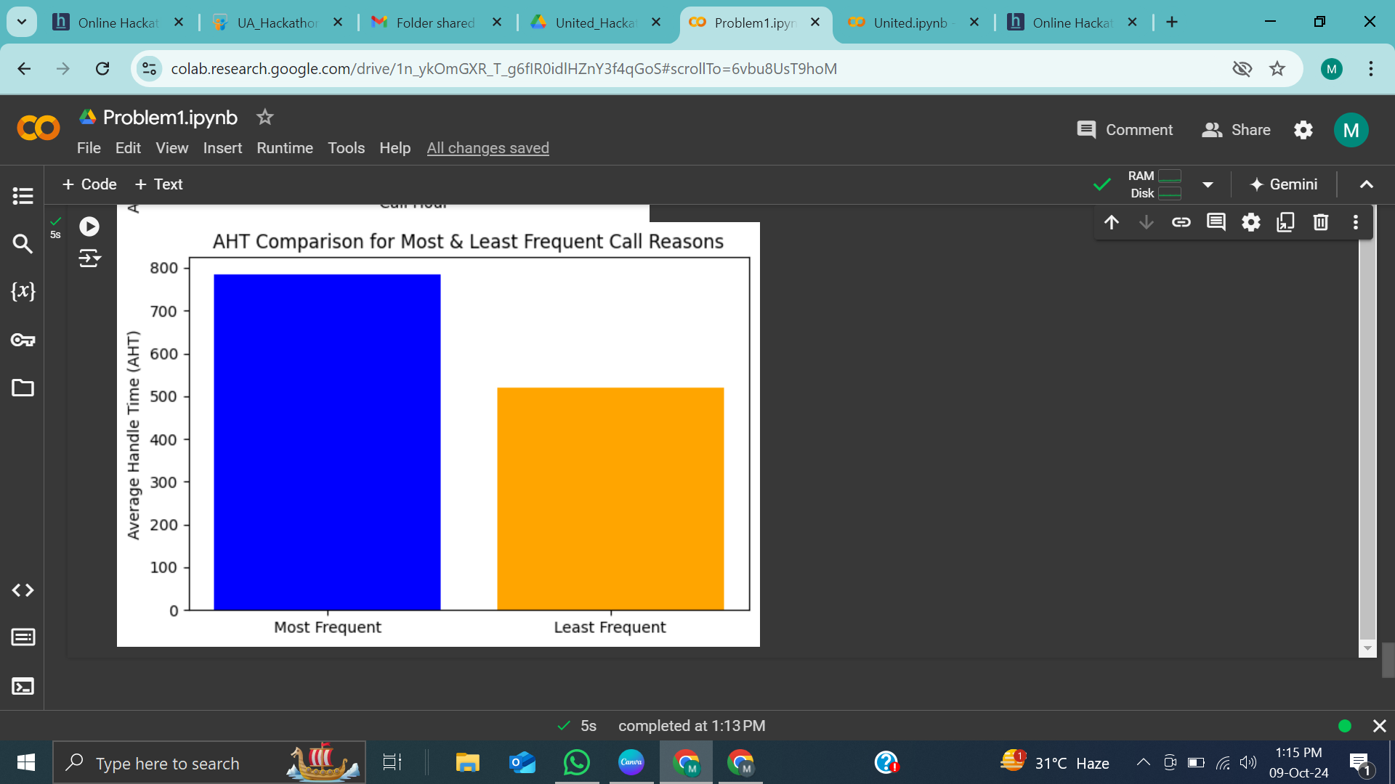
INSIGHTS
Thynk Unlimited

Slide 6
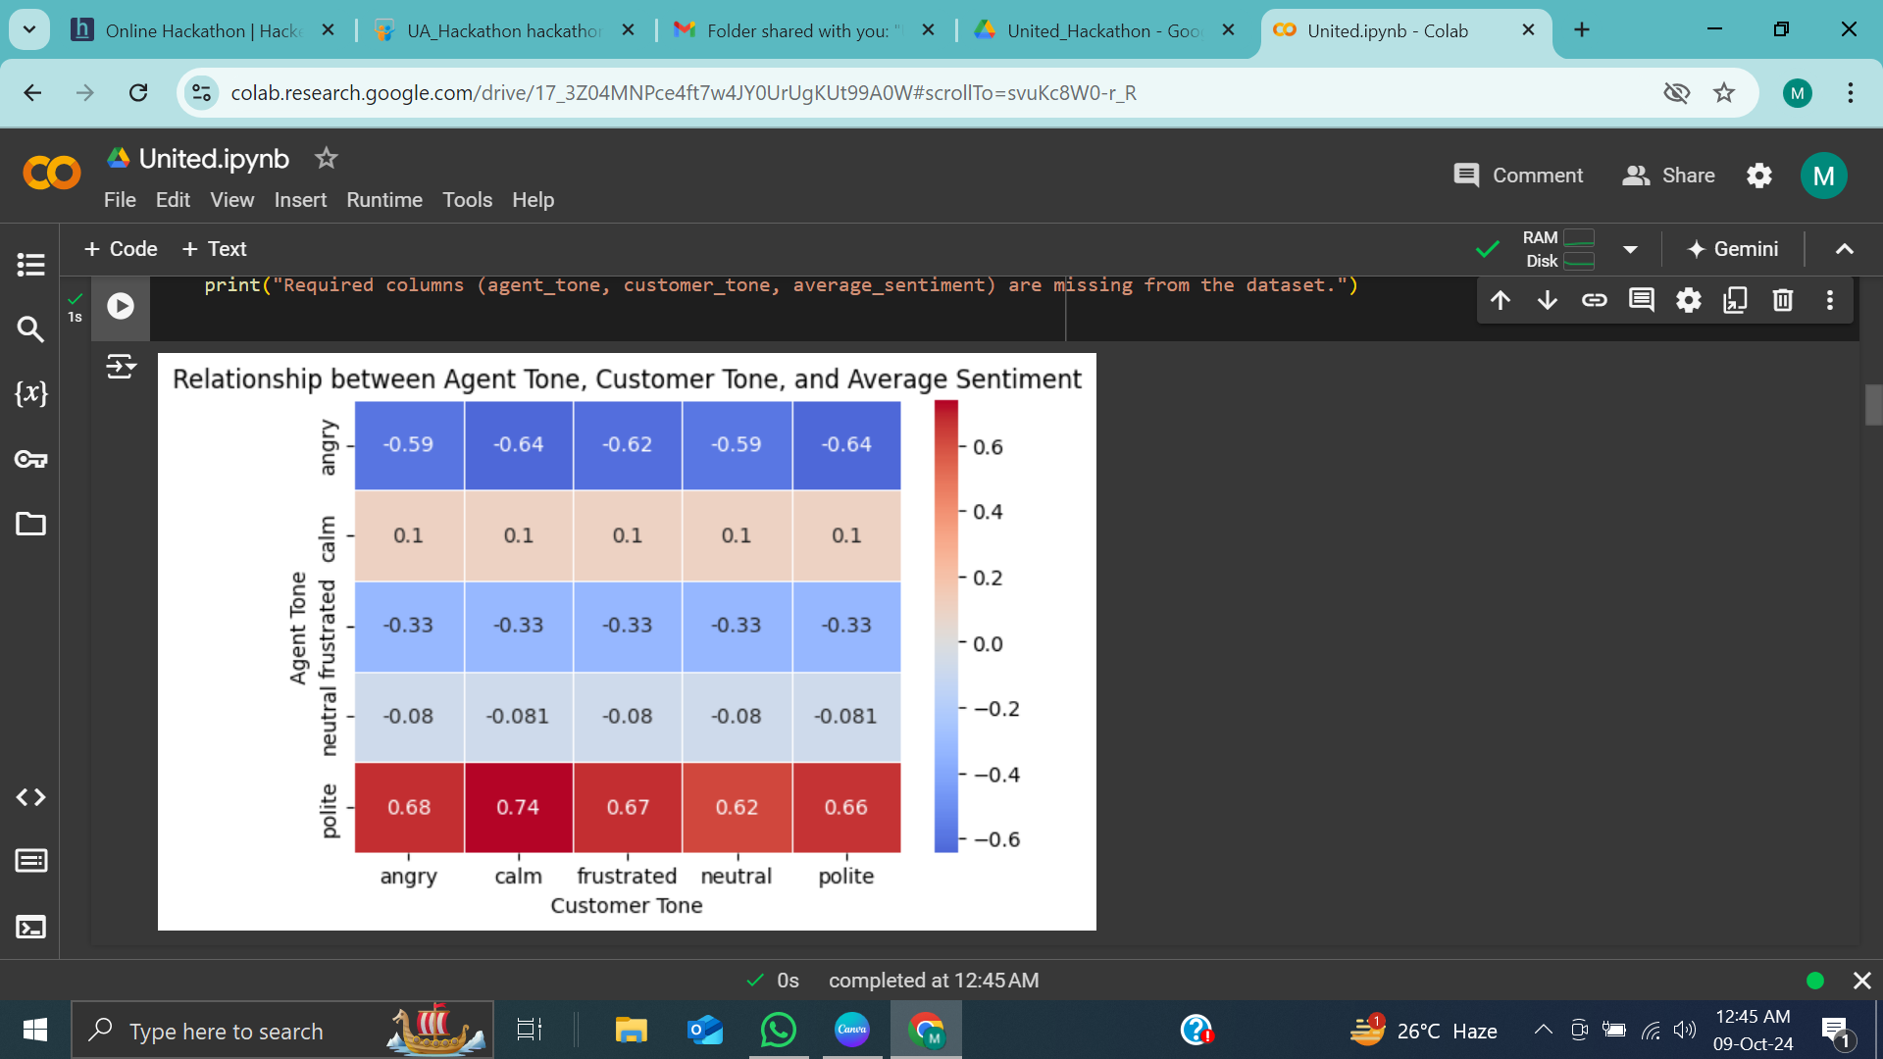
INSIGHTS
Thynk Unlimited

Slide 7
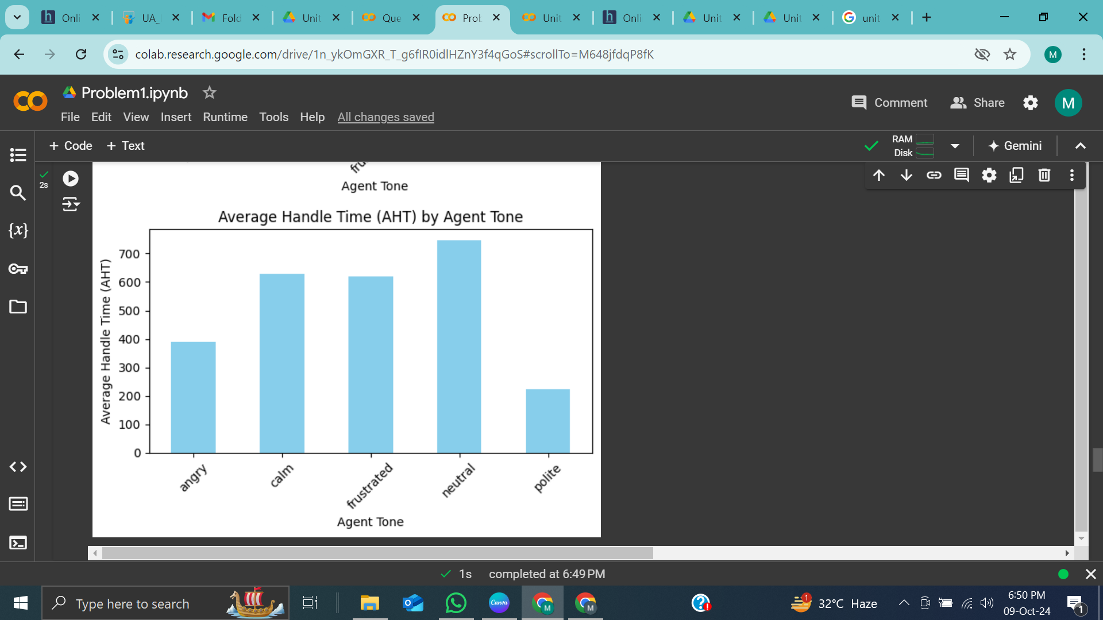
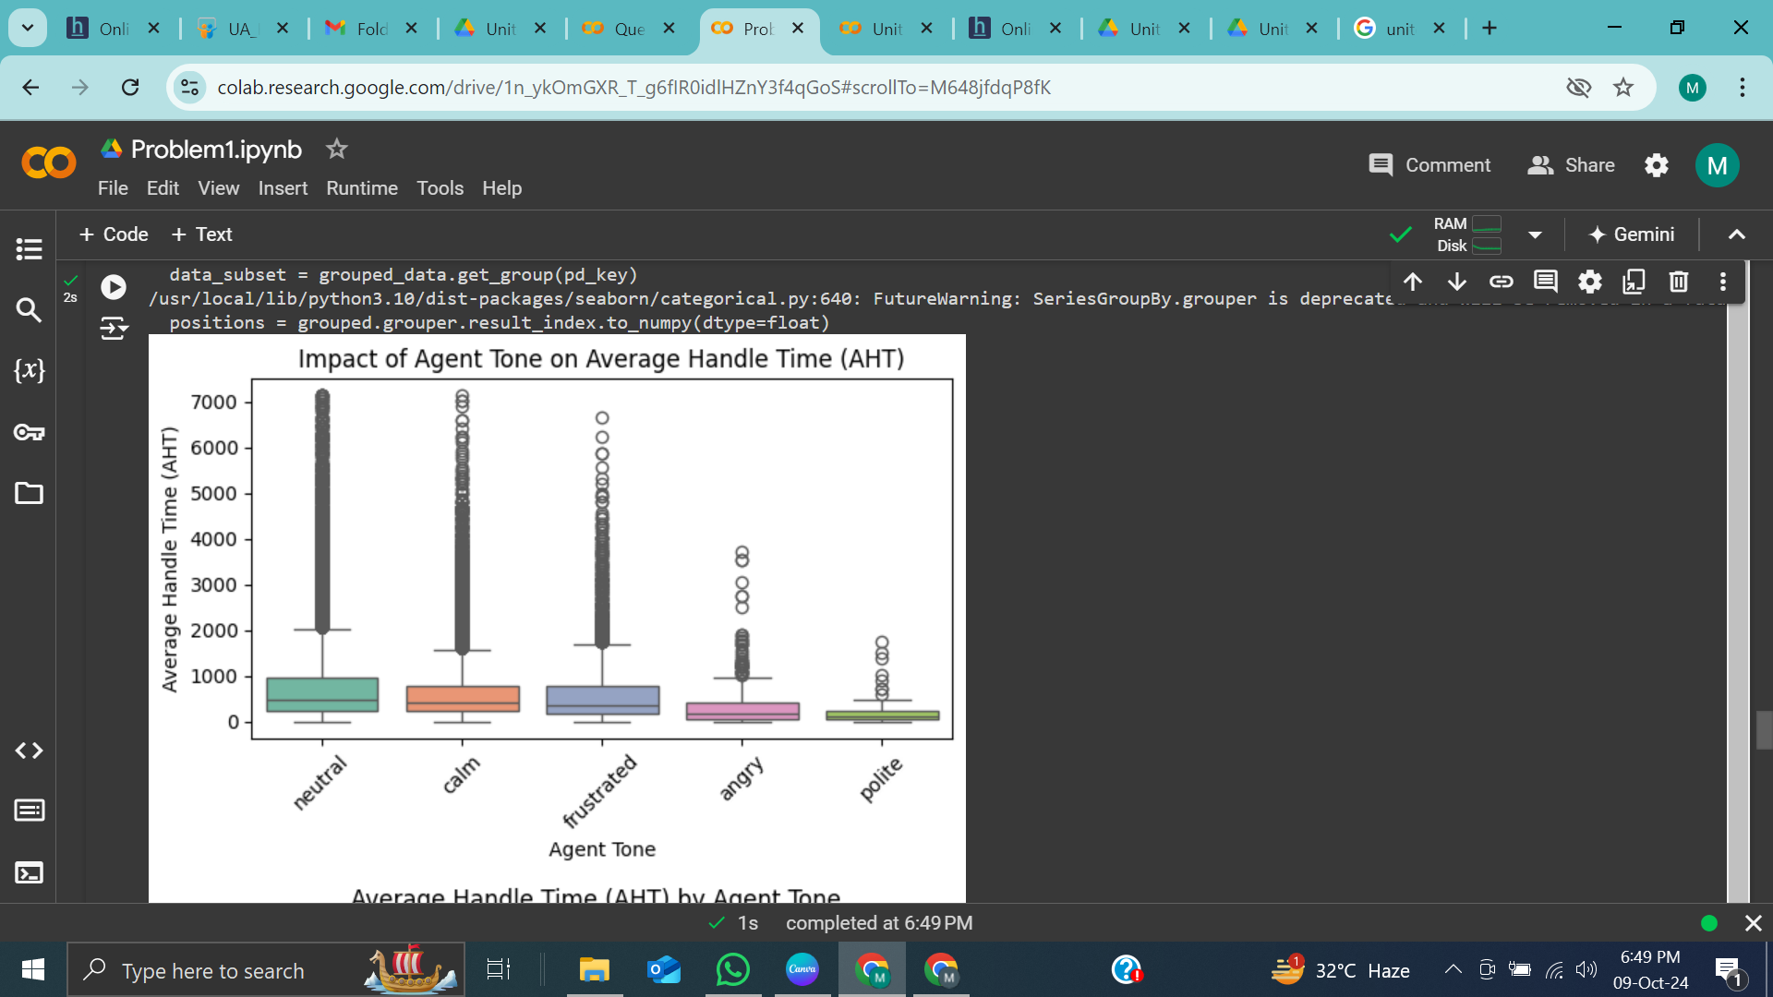
INSIGHTS
Thynk Unlimited

Slide 8
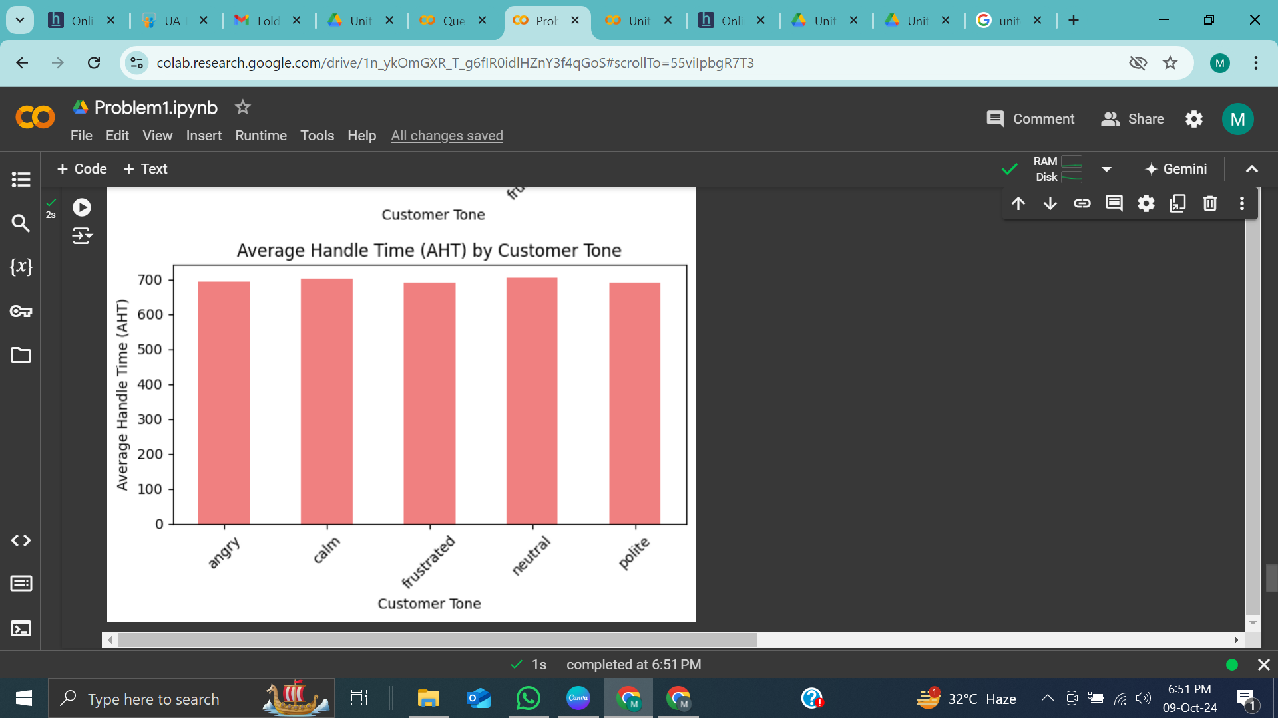
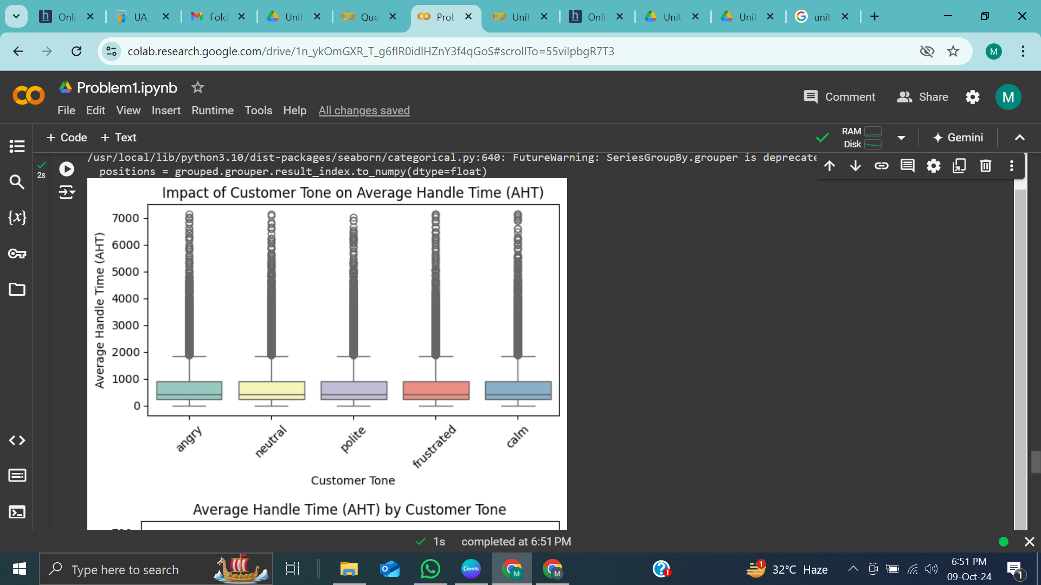
INSIGHTS
Thynk Unlimited

Slide 9
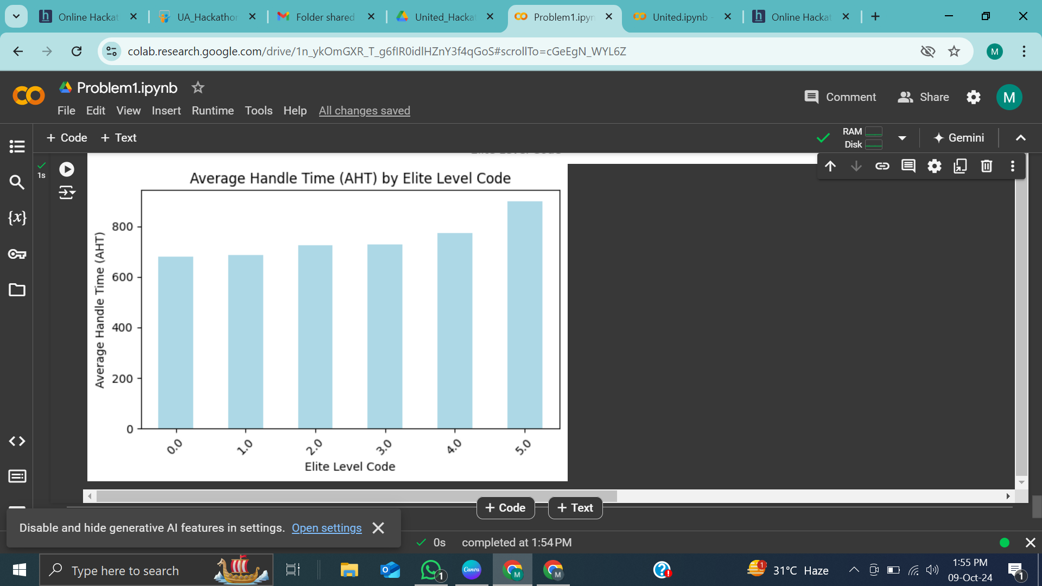
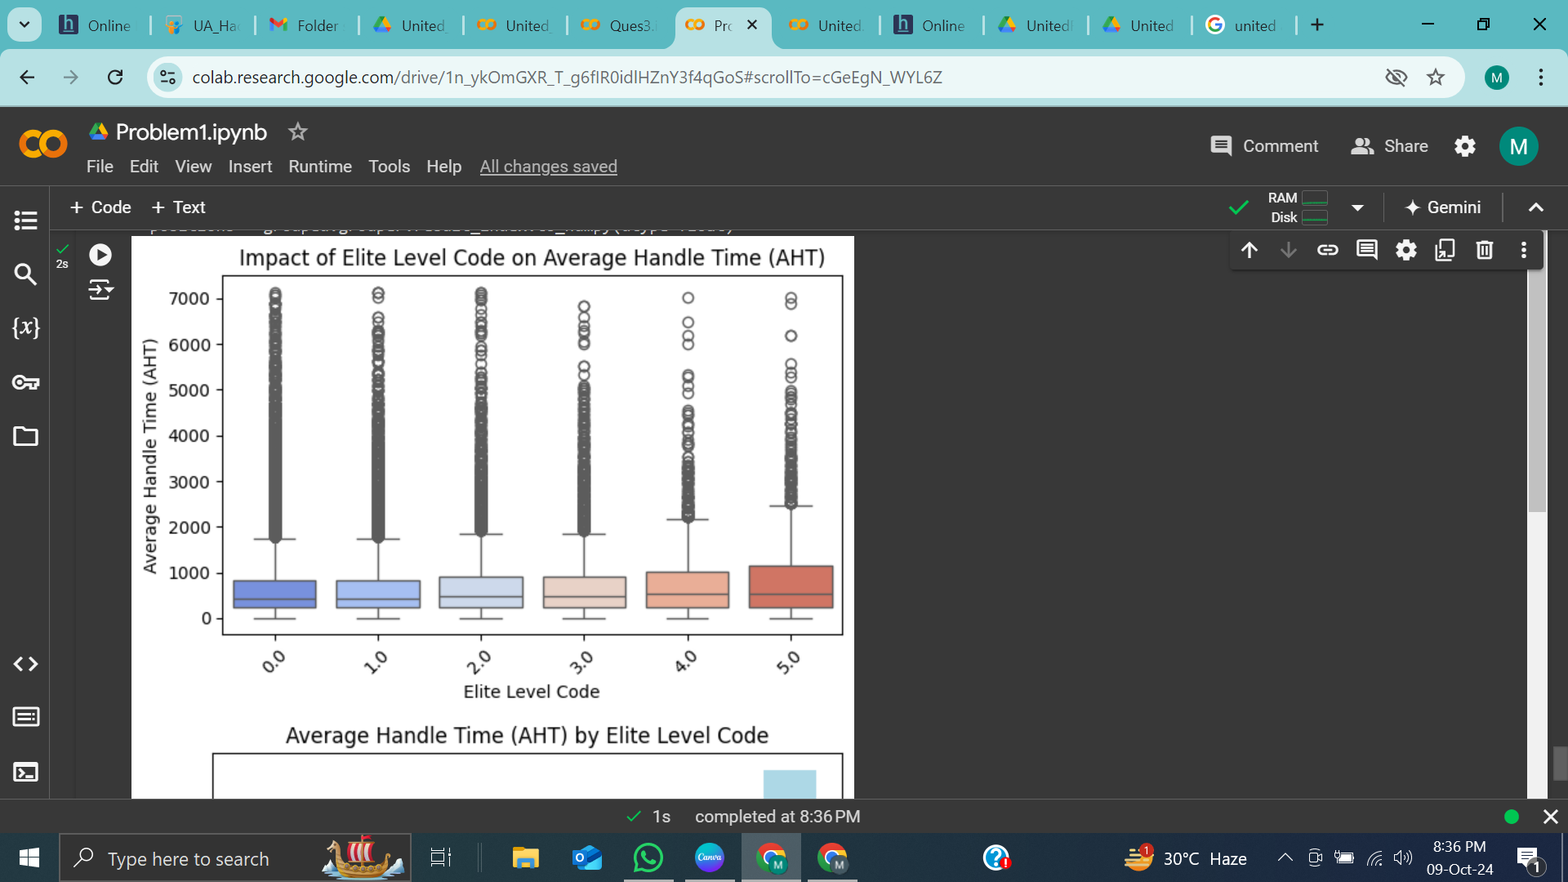
INSIGHTS
Thynk Unlimited

Slide 10
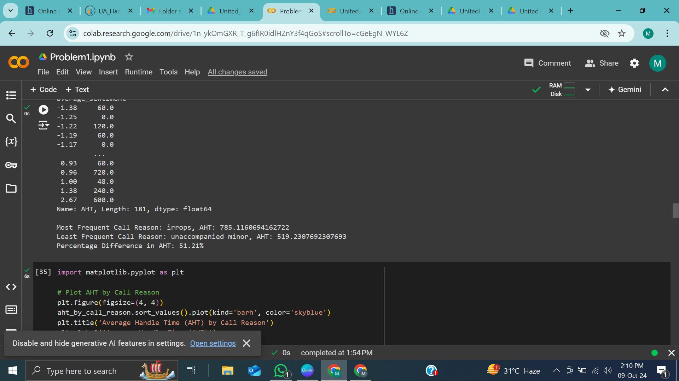
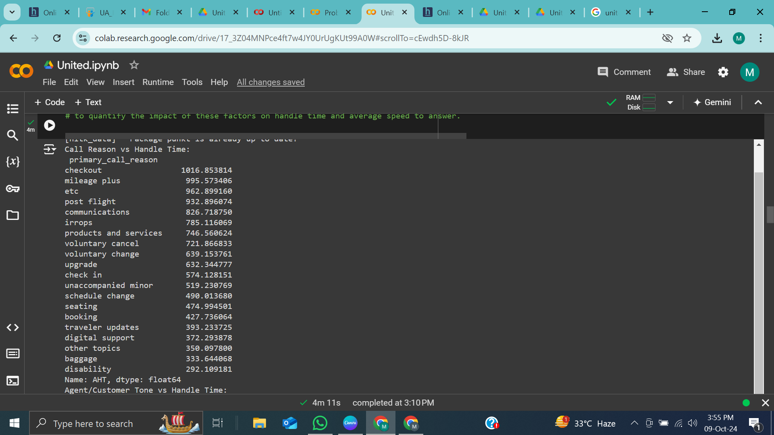
Percentage difference between the average handling time for the most frequent and least frequent call reasons
Thynk Unlimited

Slide 11
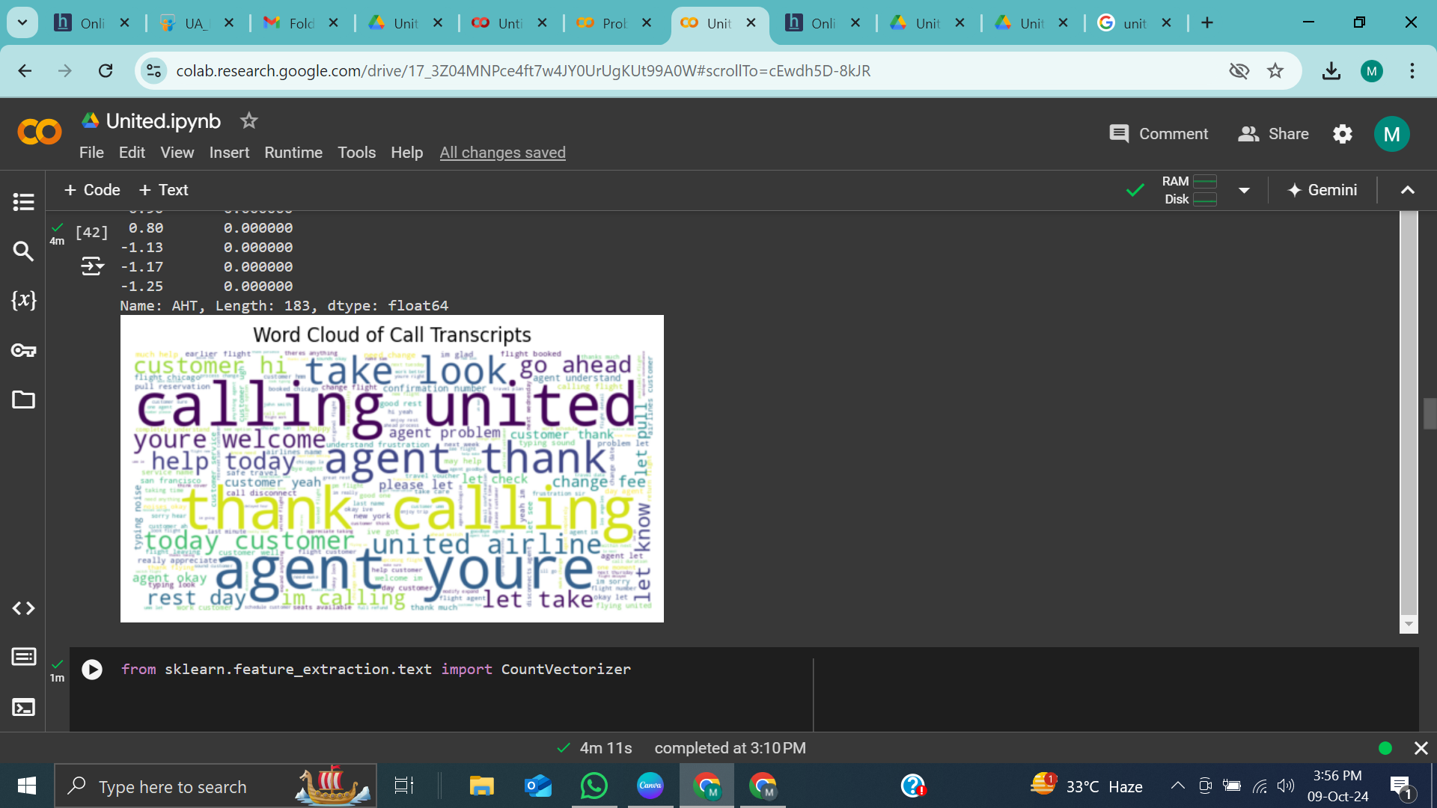
2
DELIVERABLE
Analyse the transcripts and call reasons to identify granular reasons associated to recurring problems that could be resolved via self-service options in the IVR system.
We analyze the call trascripts using NLP(natural language precessing) from which removing trailing and leading spaces,special characters and stop words

Slide 12
Insights and reason
Top 10 most frequent words in call transcripts:
[('flight', 584640),
('agent', 514677),
('customer', 506450),
('let', 280207),
('change', 227941),
('im', 220868),
('help', 186566),
('like', 180127),
('thank', 171490),
('would', 163331)]

Slide 13
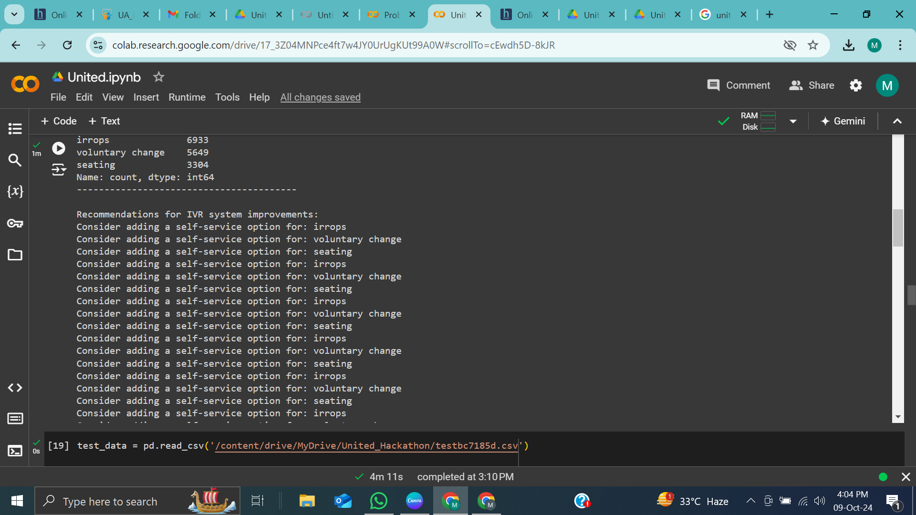
Specific improvements to the IVR options to effectively reduce agent intervention in these cases, along with solid reasoning to support your recommendations.
RECOMMENDATIONS
After Analyze the most commonly associated reasons are irrops ,voluntary change ,seating
So we can add these primary call reasons in our IVR system so that mostly customer
queries will resolve through IVR systems without agent intervention

Slide 14
3
DELIVERABLE
1. Data Preprocessing
Merged multiple datasets and handled missing values (e.g., filling average_sentiment with the mode,elite_level_code NAN values with mode and agent tone NAN values with mode).
Created new features like call_duration and vectorized call_transcript using TF-IDF.
Normalized primary_call_reason and encoded categorical features.
2. EDA
Visualized distributions of primary_call_reason and explored relationships between sentiment and call reasons.
3. Model Training
Trained a Random Forest Classifier on the dataset split into training/testing sets.
4. Evaluation
Assessed performance using precision, recall, F1-score, and confusion matrix.
5. Test Prediction
Made predictions on the test set and saved results to test_output.csv.

Slide 15
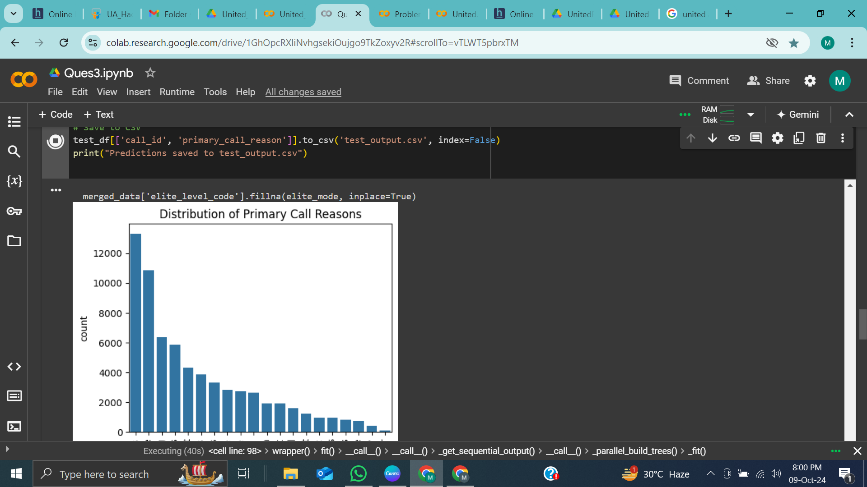
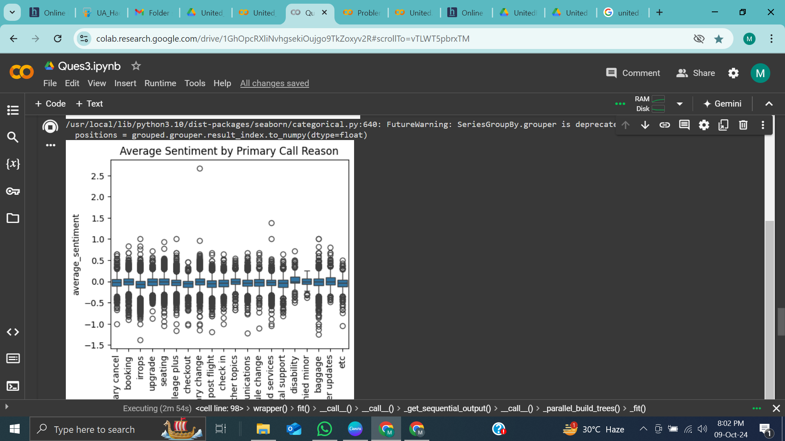
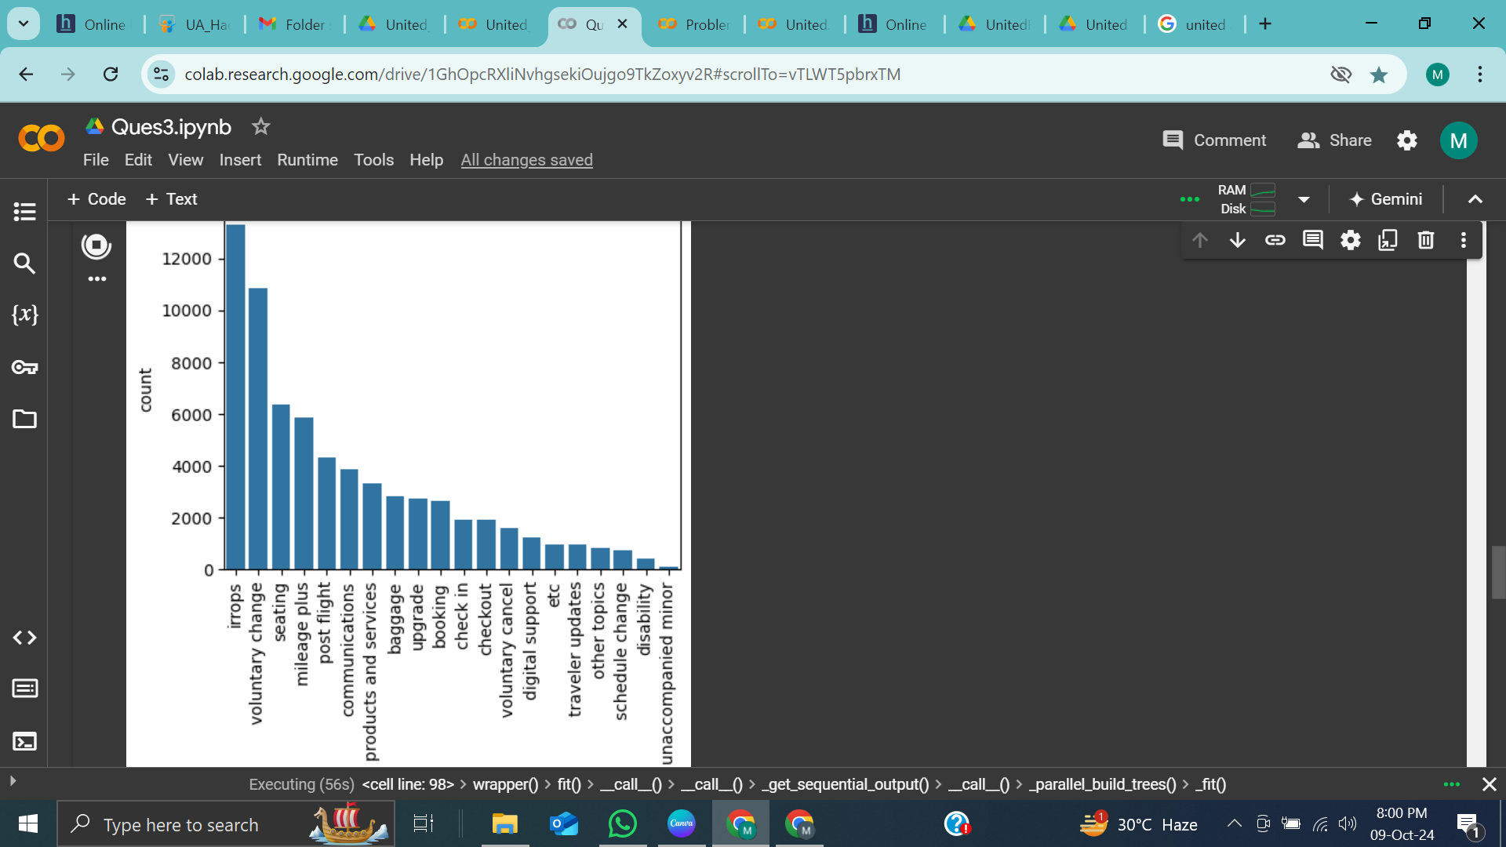
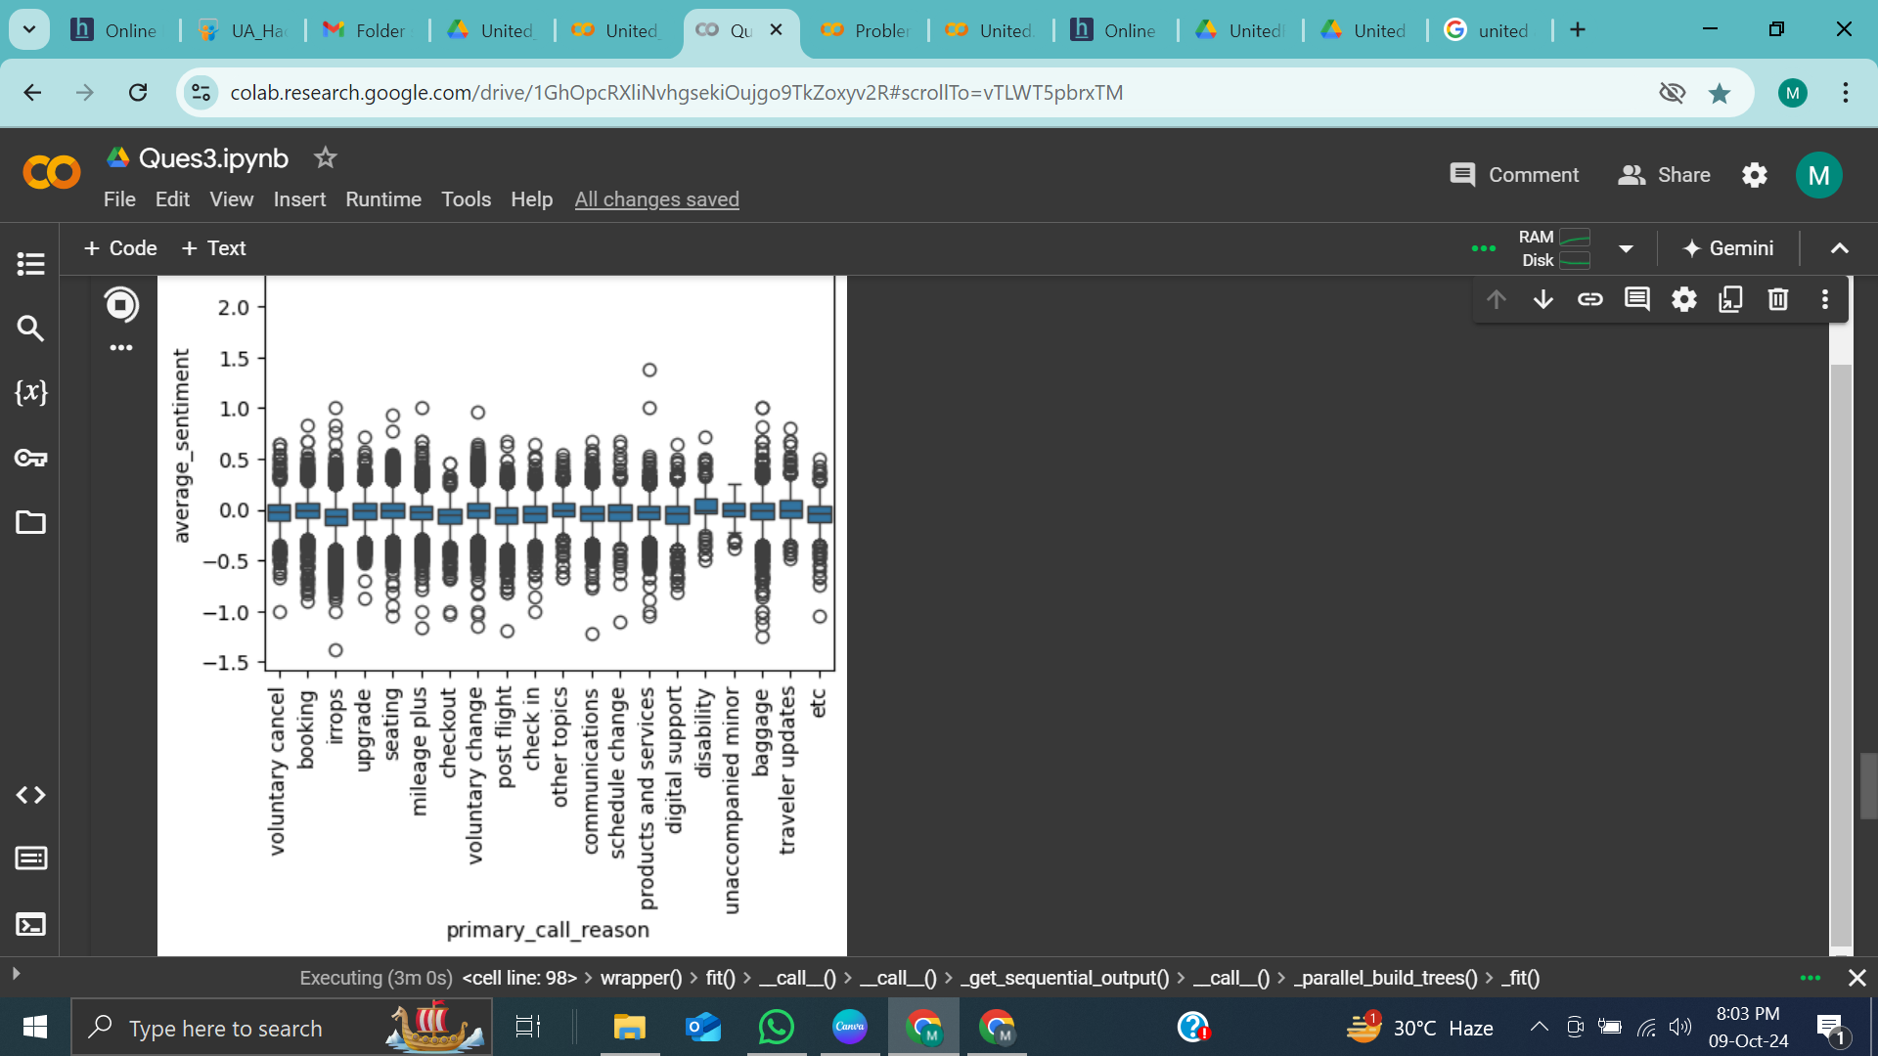

Slide 16
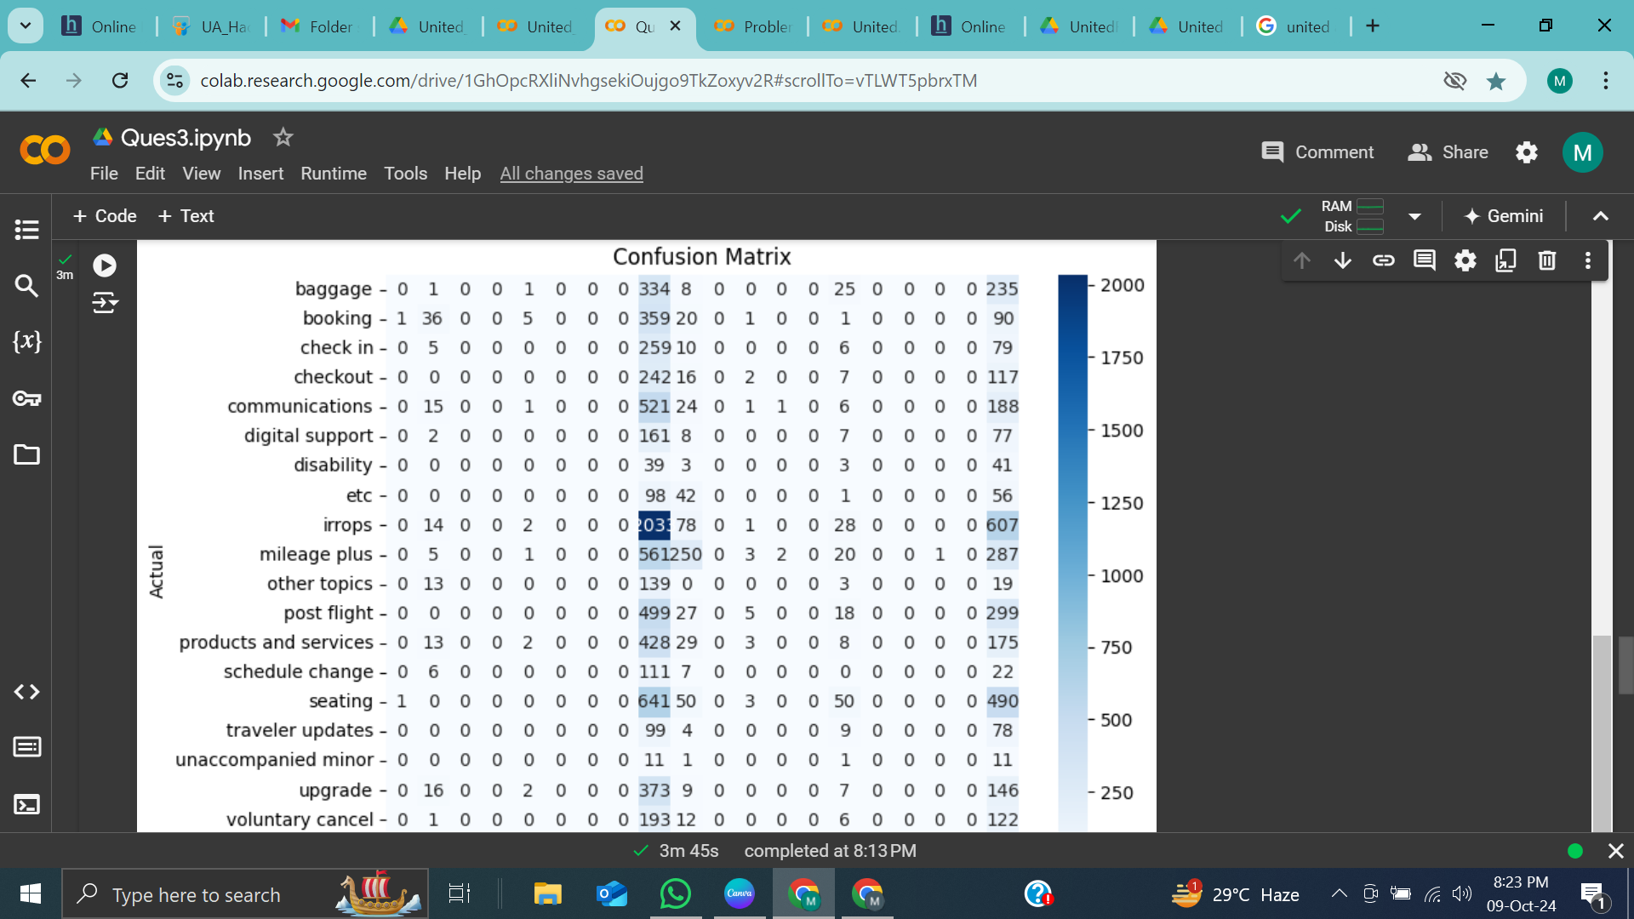
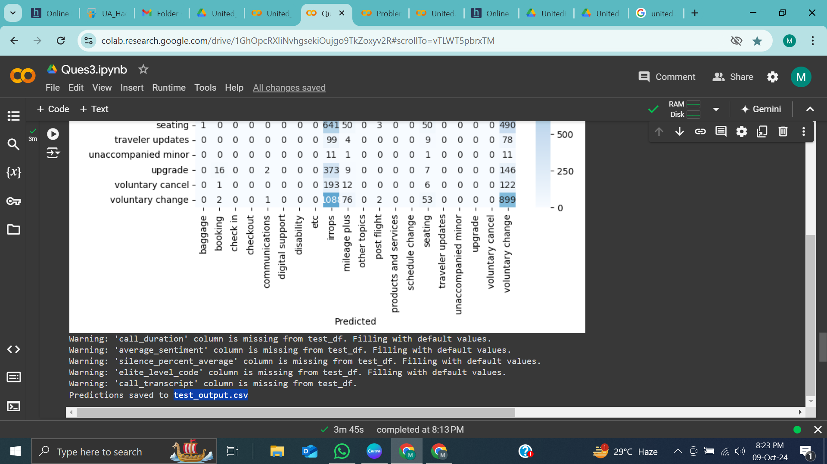

Slide 17
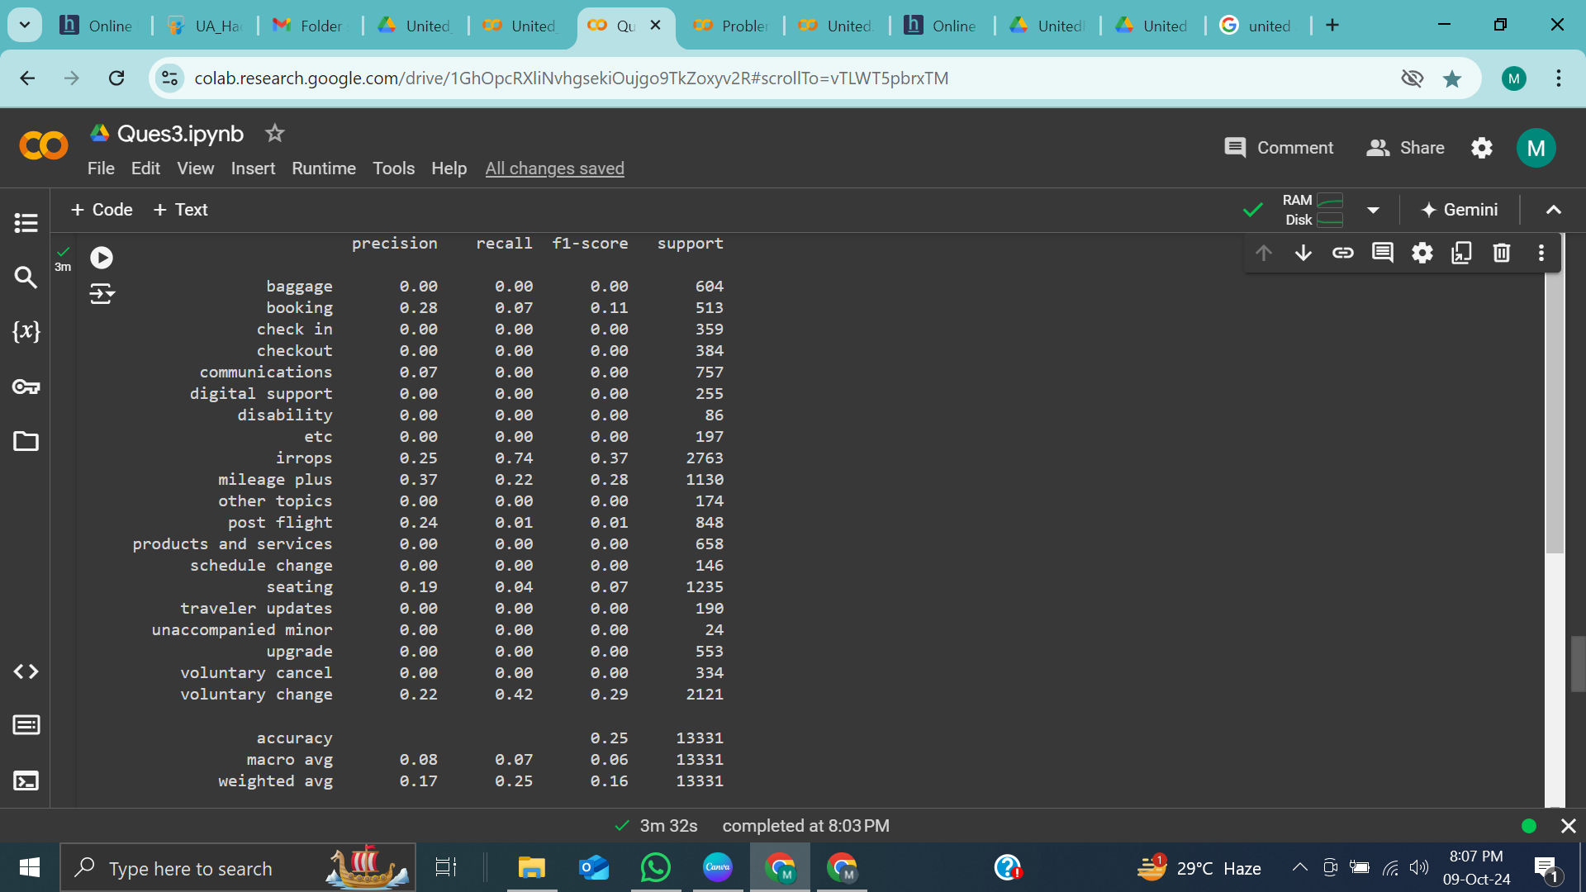
Classification metrics
Model Accuracy: 0.24559297877128497

Slide 18
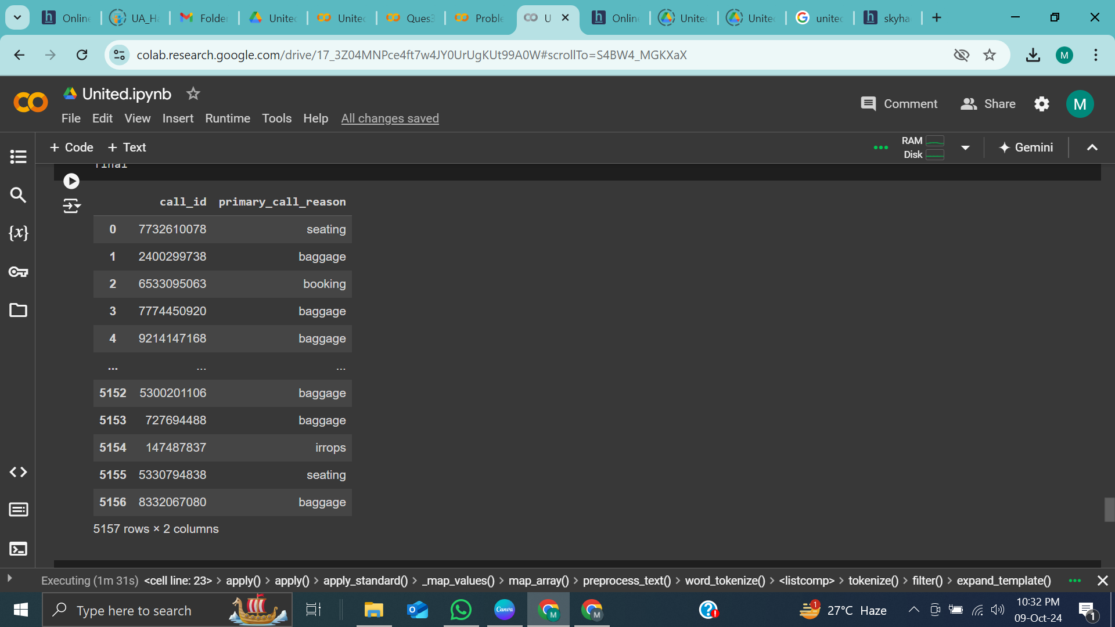
FINAL OUTPUT
Made predictions on the test set and saved results to test_shohel.csv.

Slide 19
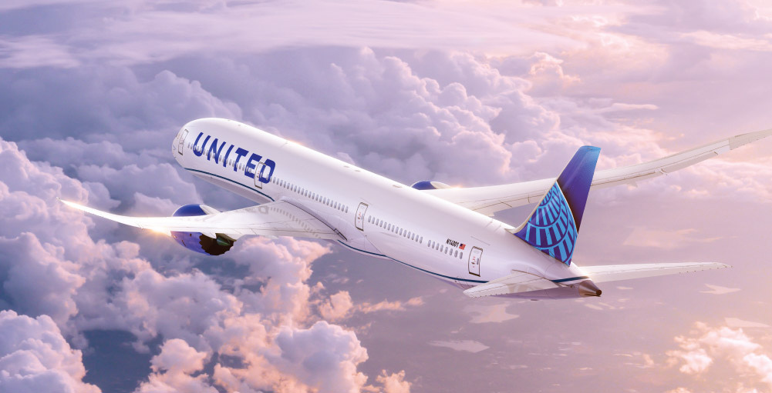
THANK YOU
FOR YOUR ATTENTION

